Slide 1
Yassir eta prediction app

Slide 2
Agenda
Introduction
Issues encountered
Models and features
RSME
WebApp interface
Results & Conclusion

Slide 3

INTRODUCTION
The Yassir Ride Hailing Company is an Algerian company with an objective of being able to accurately predict estimated time of arrival of customers to their destination.
This is a good marketing point since customers can plan with our cars in their everyday dealings.

Slide 4

Issues encountered
The Latitude and Longitude are interchanged pointing to Kenya
Weather data and trip distance alone is not enough to accurately predict ETA.
Other factors like road terrain,speed limits in cities, and number of traffic lights will greatly improve the models

Slide 5
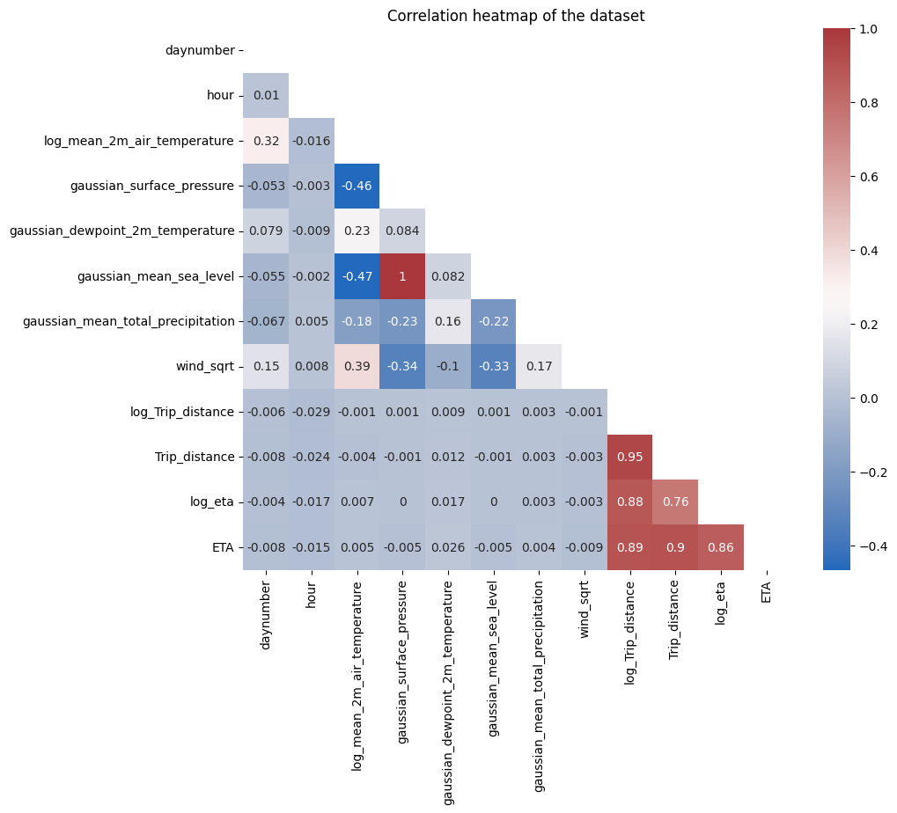
FEATURES of interest

Slide 6
FEATURES of interest
Mean_2m_air_temperature,Trip_distance,surface_pressure,mean_sea_level and dewpoint_2m_temperature were the features considered in building this model.
The log of these features was calculated and this gave a better correlation with ETA .
A gaussian filter applied to smoothen individual feature curves to improve prediction.

Slide 7
MODELs AND FEATURES
Models considered for the project are
Linear Regression
KN-Neighbours
Xgboost regressor
LGBM regressor
Support Vector Regression

Slide 8
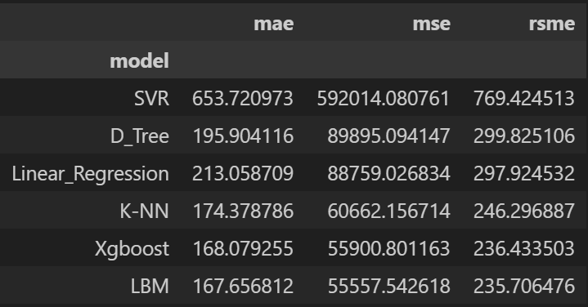
rsme

Slide 9
WebApp interface
Voice modulation is a powerful tool in public speaking. It involves varying pitch, tone, and volume to convey emotion, emphasize points, and maintain interest:
Pitch variation​
Tone inflection​
Volume control
Effective body language enhances your message, making it more impactful and memorable:
Meaningful eye contact
Purposeful gestures
Maintain good posture
Control your expressions

Slide 10
Navigating Q&A sessions
Know your material in advance​
Anticipate common questions​
Rehearse your responses
Maintaining composure during the Q&A session is essential for projecting confidence and authority. Consider the following tips for staying composed:​
Stay calm​
Actively listen​
Pause and reflect​
Maintain eye contact

Slide 11

Speaking impact​
Your ability to communicate effectively will leave a lasting impact on your audience​
Effectively communicating involves not only delivering a message but also resonating with the experiences, values, and emotions of those listening

Slide 12
Dynamic delivery​
Learn to infuse energy into your delivery to leave a lasting impression​
One of the goals of effective communication is to motivate your audience
Metric​ | Measurement​ | Target​ | Actual​
Audience attendance​ | # of attendees​ | 150​ | 120​
Engagement duration​ | Minutes​ | 60​ | 75​
Q&A interaction​ | # of questions​ | 10​ | 15​
Positive feedback​ | Percentage (%)​ | 90​ | 95​

Slide 13
Final tips & takeaways​
Consistent rehearsal​
Practice makes perfect, so strengthen your familiarity with the presentation​
Refine delivery style​
Pacing, tone, and emphasis​
Timing and transitions​
Aim for seamless, professional delivery​
Practice audience
Enlist colleagues to listen & provide feedback​
Seek feedback​
Reflect on performance​
Explore new techniques​
Set personal goals​
Iterate and adapt

Slide 14
Speaking engagement metrics​
Impact factor​ | Measurement​ | Target​ | Achieved​
Audience interaction​ | Percentage (%)​ | 85​ | 88​
Knowledge retention​ | Percentage (%)​ | 75​ | 80​
Post-presentation surveys​ | Average rating​ | 4.2​ | 4.5​
Referral rate​ | Percentage (%)​ | 10​ | 12​

Slide 15
THANK YOU
Brita Tamm​
502-555-0152​
brita@firstupconsultants.com​
www.firstupconsultants.com

